Slide 1


Empower Europe: Sustainable solutions through Nuclear Energy
Lorenzo Eaco, Kia Ris Skræddergaard, Bert Vandeborg, Robbe Verhoeven

Slide 3
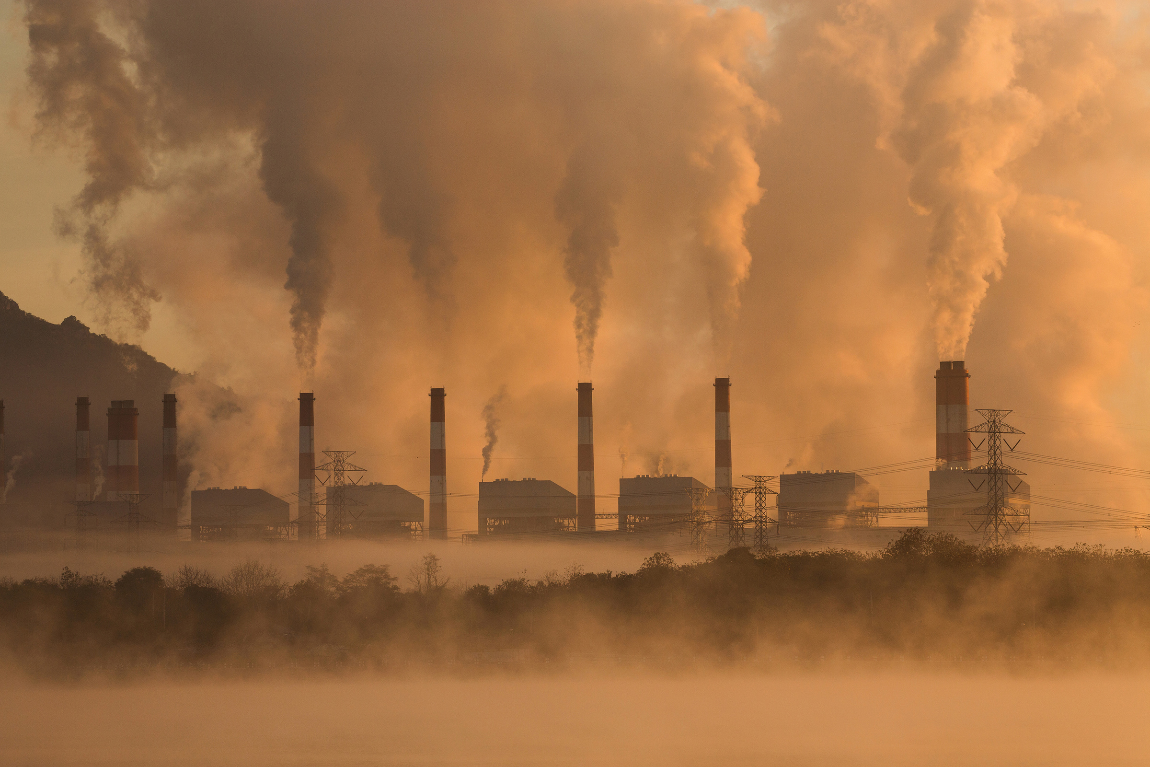

Slide 4
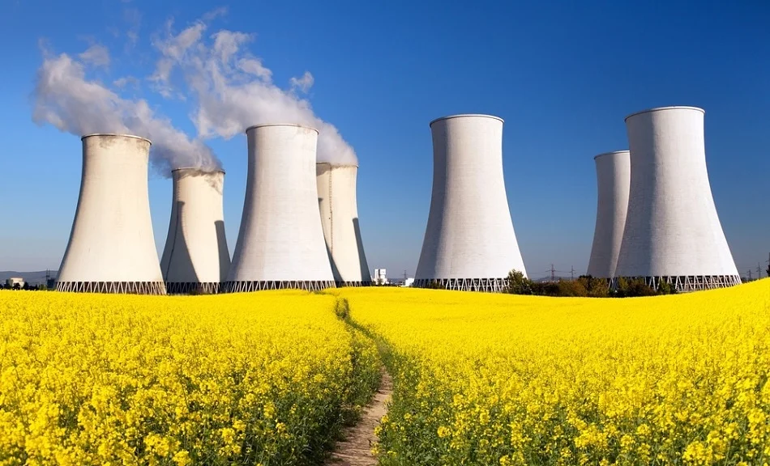

Slide 5





OVERALL GOAL
Drafting a skeleton for a political framework intended for revision of existing EU-legislation, incorporating nuclear energy as a vital component, and setting up the financial structure for the integration and development of nuclear energy within the EU.
Overall goal
Drafting a political framework
Revising current legislation
Financial structure

Slide 6

REVISIONS
Economic activities related to nuclear energy defined as sustainable and aligned with the neto zero objectives to enable up-scaling of investments for the integration and development of the nuclear energy sector.
EU Taxonomy for Sustainable Activities
Include paragraphs on nuclear energy as a legitimate renewable energy source that must contribute to the net zero objectives, while also being integrated within the cooperation mechanisms.
Renewable Energy Directive
Revise to include nuclear energy for provisions on permit-granting procedures and facilitating power purchase agreements to position nuclear energy as a legitimate energy source in the EU’s energy strategy, and signal a recognition of nuclear energy as a contributor to the green transition.
REPowerEU
Strengthening the PINC in terms of nuclear safety and greater possibilities for upgrading existing nuclear power plants, and to develop societal and political support for nuclear energy.
Nuclear Illustrative Program

Slide 7
THE FINANCIAL STRUCTURE
To make sure that new nuclear energy projects can receive funding and loans under the REPowerEU budget. Will be possible if a revision encompasses nuclear energy.
REPowerEU
Strong allocation of funding for green investment, why it is important to define nuclear energy as green energy to be able to receive funding.
The Green Deal
One of the largest funding programmes in the EU for research and innovation, making sure research and innovative on nuclear energy can receive funding.
Horizon Europe
The inclusion of nuclear energy opens up and enables national co-funding for joint nuclear energy projects between two or more EU-countries or third-countries.
Joint and national support schemes

Slide 8


Stakeholder Mapping
Identifying key players intertwined with our plan

Slide 9








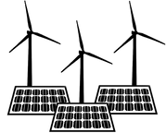








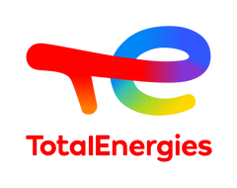





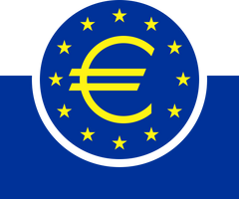







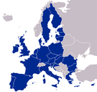


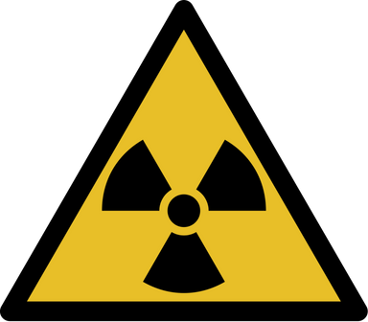




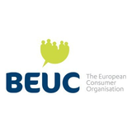

Research Institutions
CERN, Max Planck Society, Universities
Renewable Energy Companies
Vestas, Siemens Games, Enel Green Power, Ørsted, ACCIONA Energìa
National Energy Companies
Enel, Iberdrola, Orsted, Verbund,
Carbon-related workers
Tech Companies
ASML, SAP, Prosus, Dassault Systèmes, Adyen
We have identified 20 different types of stakeholders.
International financial organizations
IMF, WB, European Central Bank
Fossil Fuel Companies
Shell, BP, TotalEnergies, Eni, Equinor, Repsol
ENS Corporate Members
National Public Trasportation Companies
Socio-economic interest groups
ETUC, National Households Associations, Labor Unions
Media Outlets
EU Member States
Eurobusiness (Trade Associations)
Nuclear waste management companies
Local Communities
Engaging with more than fifty actors in various ways.
EU Commission
DGs, EU Commission Officials
International Energy Organizations
IEA, IRENA, WEC, IAEA, WNN
Environmental NGOs Activist Groups
Greenpeace, WWF, EEB, CAN, European, Extinction Rebellion
Clean Energy Industrial Forum
Consumer Organizations
BEUC, National consumers organizations

Slide 10
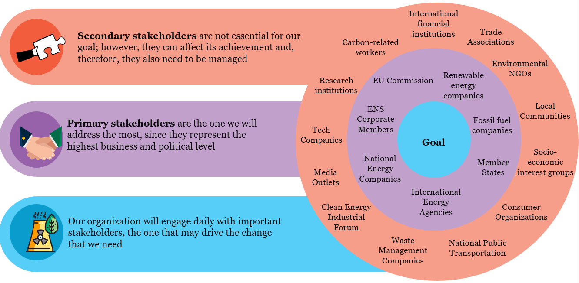

Slide 11
HIGH
Keep Satisfied | Manage Closely
Monitor | Keep Informed
Research Institutions
International Financial Institutions
Media Outlets
EU Commission (DGs, Officials)
Renewable Energy Companies
Fossil fuel companies/interest groups
Member States
International Energy Agencies
National Energy Companies
ENS Corporate Members
Influence
Consumer Organizations
Socio-economic interest groups
Local communities
Eurobusiness (Trade Association)
Environmental NGOs
National Public Transportation
Waste Management Companies
Clean Energy Industrial Forum
Tech Companies
Interest
LOW
HIGH

Slide 12


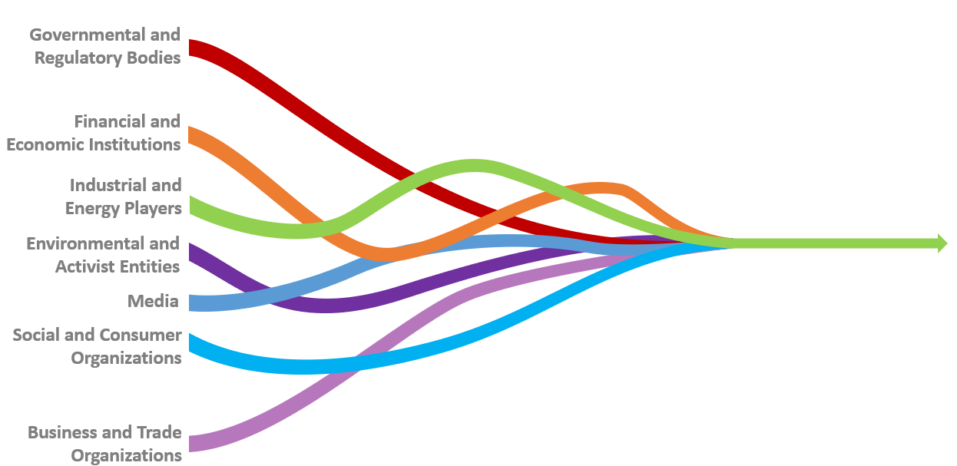
The crowded environment we are into requires us to tackle only specific actors, due to time and resource constraints
Even though not all stakeholders are crucial today, they may become significant in the near future or in the upcoming steps of the PA plan.
To shape EU rules we have to build coalitions - both with complementary actors and competitors.

Slide 13
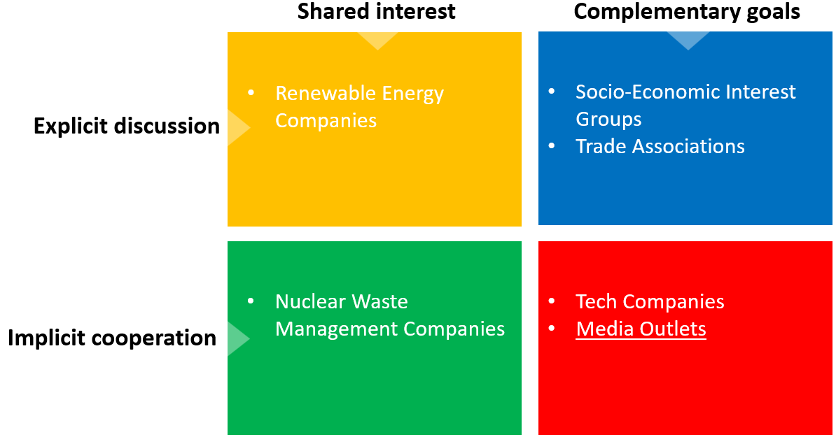

Slide 14



Action!

Slide 15

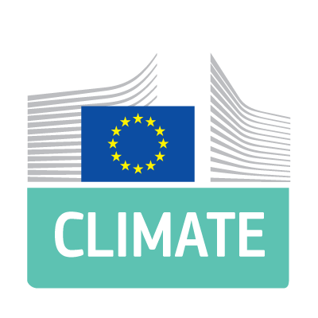


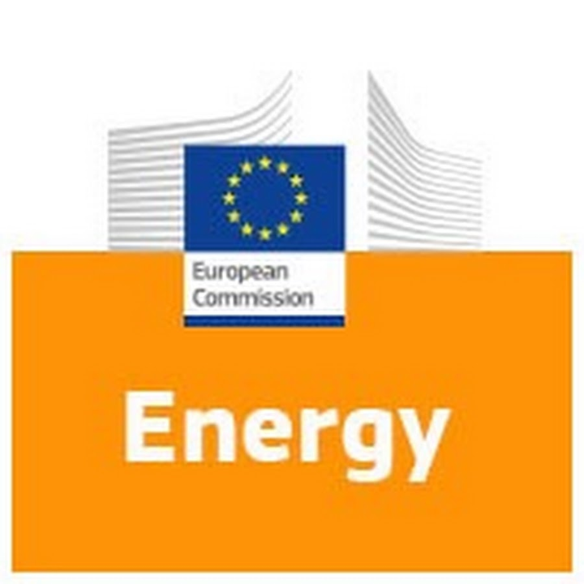



03
02

Slide 16






EMPOWERING OUR SOCIETY
Towards a bright and clean future, where our society can grow and glow
Our Businesses
Our Families
Our Transport
Our Environment

Slide 17

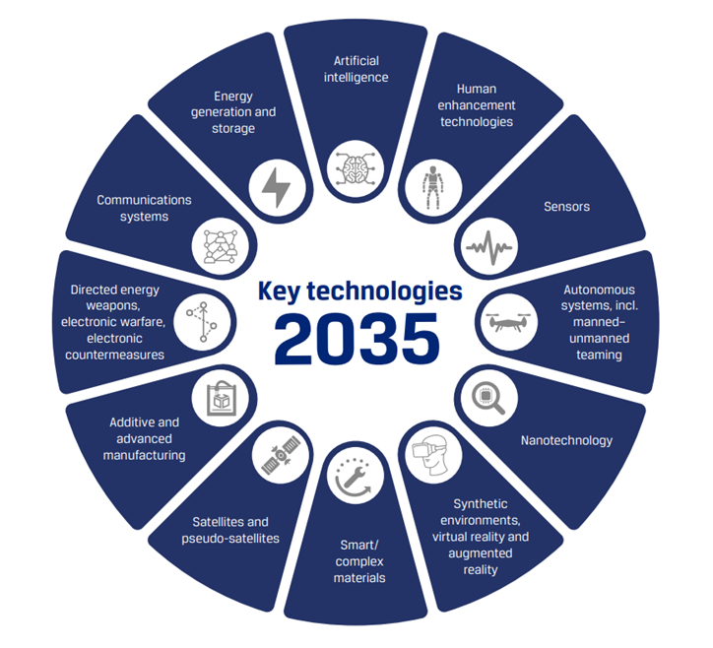


STRATEGIC AUTONOMY
Independence
Stability
Certainty

Slide 18
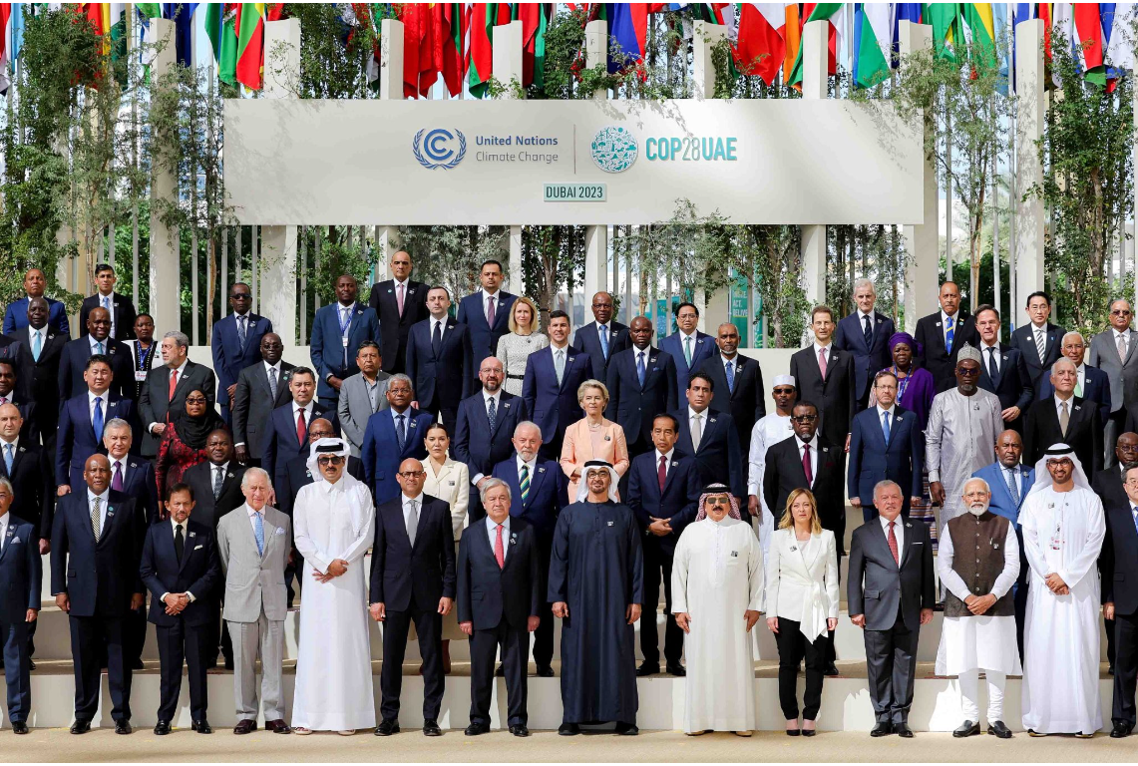

Slide 19
References
Eurobarometer. (n.d.). Eurobarometers on energy. Energy.ec.europa.eu. https://energy.ec.europa.eu/data-and-analysis/eurobarometers-energy_en
European Commission. (n.d.-a). Clean energy competitiveness. Energy.ec.europa.eu. https://energy.ec.europa.eu/topics/research-and-technology/clean-energy-competitiveness_en
European Commission. (n.d.-b). Cooperation mechanisms. Energy.ec.europa.eu. https://energy.ec.europa.eu/topics/renewable-energy/renewable-energy-directive-targets-and-rules/cooperation-mechanisms_en
European Commission. (n.d.-c). Enabling framework for renewables. Energy.ec.europa.eu. https://energy.ec.europa.eu/topics/renewable-energy/enabling-framework-renewables_en
European Commission. (2021). Horizon Europe. Research-And-Innovation.ec.europa.eu. https://research-and-innovation.ec.europa.eu/funding/funding-opportunities/funding-programmes-and-open-calls/horizon-europe_en
European Commission. (2022a). Renewable energy directive. Energy.ec.europa.eu. https://energy.ec.europa.eu/topics/renewable-energy/renewable-energy-directive-targets-and-rules/renewable-energy-directive_en
European Commission. (2022b). Renewable energy targets. Energy.ec.europa.eu. https://energy.ec.europa.eu/topics/renewable-energy/renewable-energy-directive-targets-and-rules/renewable-energy-targets_en
European Nuclear Society. (2019, June 29). Position Papers. ENS. https://www.euronuclear.org/scientific-resources/position-papers/
European Parliament. (2022). BRIEFING EU Strategic Autonomy Monitor. https://www.europarl.europa.eu/RegData/etudes/BRIE/2022/733589/EPRS_BRI(2022)733589_EN.pdf
European Union. (2012). EUR-Lex - 12012A/TXT - EN - EUR-Lex. Europa.eu. https://eur-lex.europa.eu/legal-content/EN/TXT/?uri=CELEX:12012A/TXT
European Union. (2017). COMMUNICATION FROM THE COMMISSION Nuclear Illustrative Programme presented under Article 40 of the Euratom Treaty - Final (after opinion of EESC). https://eur-lex.europa.eu/legal-content/en/ALL/?uri=CELEX:52017DC0237
Ritchie, H. (2020, February 10). What Are the Safest and Cleanest Sources of energy? Our World in Data. https://ourworldindata.org/safest-sources-of-energy
Ritchie, H., Roser, M., & Rosado, P. (2022). Nuclear Energy. Our World in Data. https://ourworldindata.org/nuclear-energy

